Slide 1
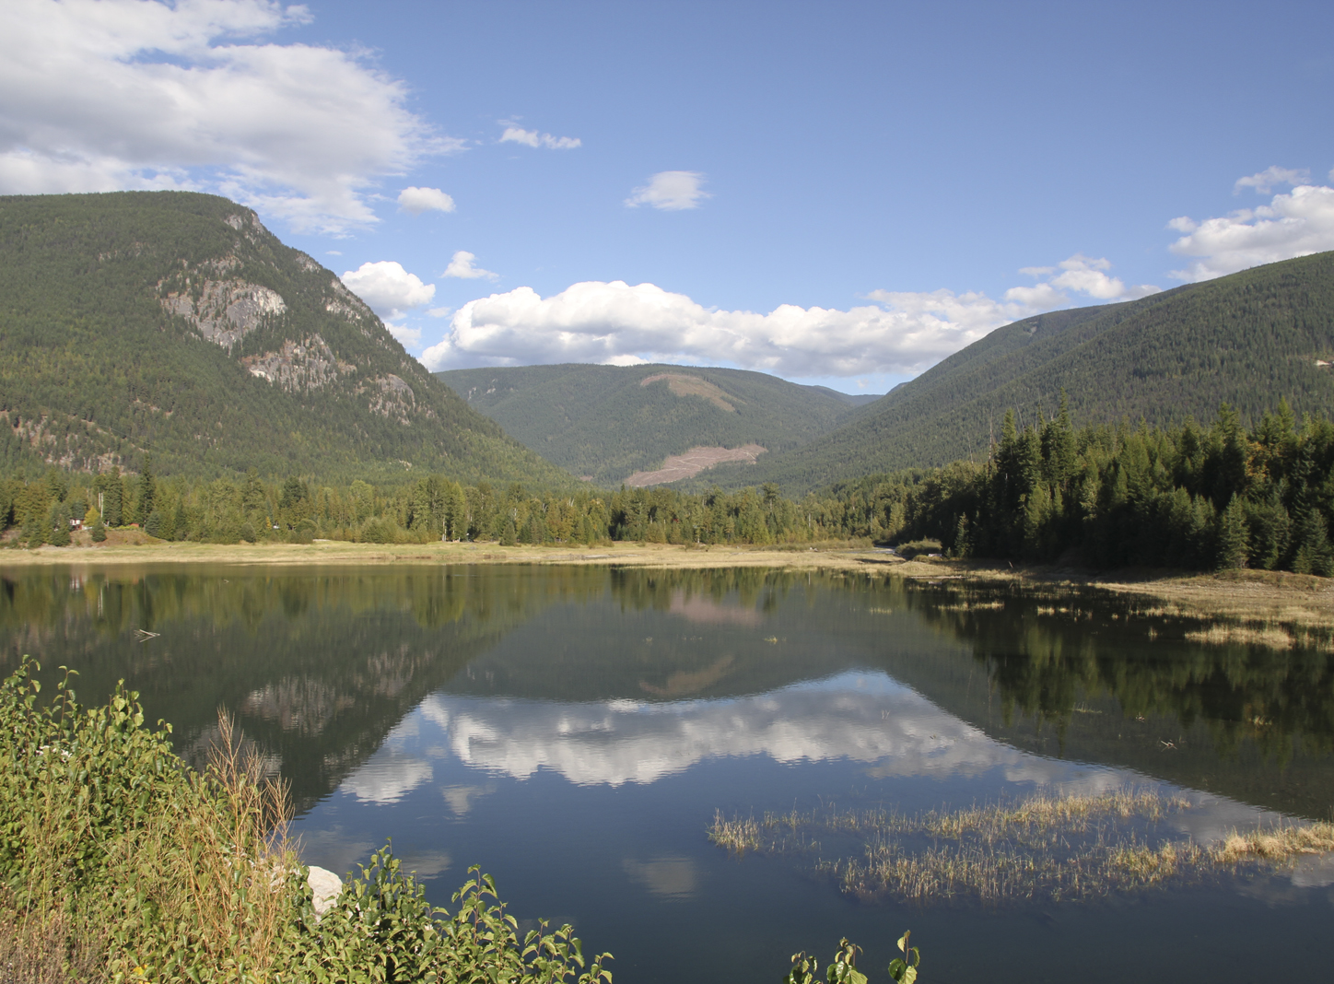

Visual Quality
FREP Evaluation Training
Ministry of
Forests, Lands and
Natural Resource Operations

Slide 2
Course Objectives
At the end of this course participants will:
understand the role of a Visual Quality Effectiveness Evaluation (and VQO Inspection), and
have the knowledge to complete a Visual Effectiveness Evaluation (VQO Inspection) form in its entirety.
2

Slide 3
FREP Evaluation vs. C&E Inspection
FREP
Multiple samples necessary.
Openings chosen randomly.
Evaluates trends over time.
Reporting out looks at what action is needed to improve practices i.e. Training.
Evaluation procedure similar to Inspection.
Numerical assessment has equal wt. to ocular assessment.
Evaluations could alert C&E to potential issues.
C&E Inspection
Generally a single sample.
Openings are targeted.
Evaluates compliance with VQO.
Reporting out may lead to an investigation and penalties.
Inspection procedure similar to evaluation.
Numerical assessment supports ocular assessment.
Inspections could contribute to FREP sampling.
3

Slide 4
Visual Effectiveness Evaluation
What is it?
It is a process and set of criteria used to determine whether established visual quality objectives (VQO’s) are being achieved.
Role:
Its role is to provide information on resource status/trends, which in turn will identify if forest legislation, policies and practices are working.
4

Slide 5

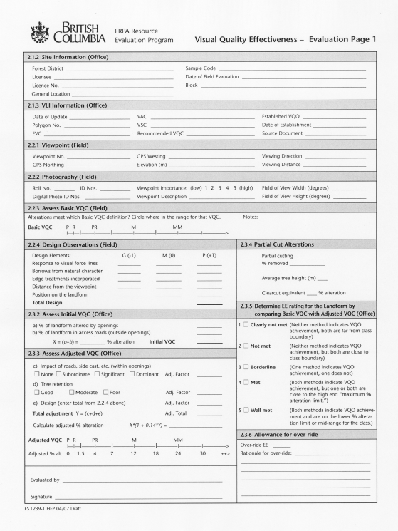
Visual Effectiveness Evaluation
Draft procedures & standards document released July 2004 and revised in 2005. Finalized in 2008.
The procedures & standards were developed to be applied to a single block or multiple blocks visible from given viewpoints suitable for Resource Stewardship Monitoring or may be used more broadly at a regional or provincial level.
5

Slide 6
Background
FREP data is collected at the district level by staff and by contractors using the FREP Visual protocol.
Sampling results are rolled up regionally and provincially to determine management trends.
Between 2006-2009 the goal was to learn how successful we were at managing Visuals under the Code.
Extension Note #13 presents the results of Code sampling. The conformance rate provincially was 63%.
Between 2009 and 2012 the goal was to learn how successful we were at managing Visuals under FRPA.
Extension Note#32 presents the results of FRPA sampling. The conformance rate provincially was 69%.
6

Slide 7
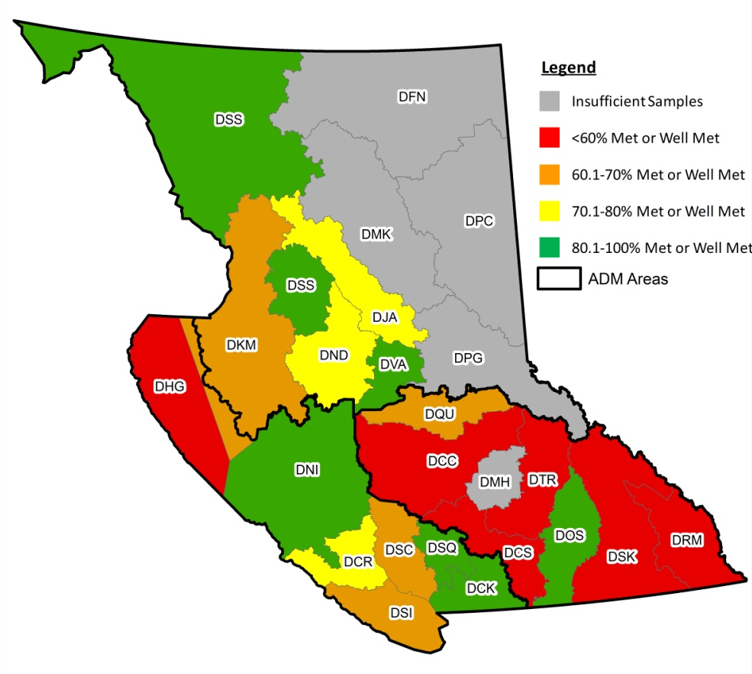
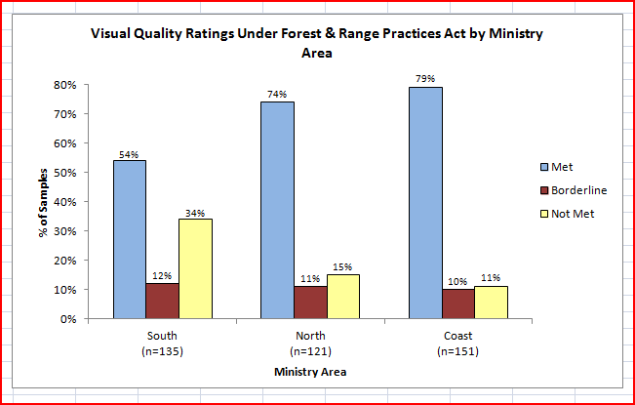
          Visual Monitoring Results
FREP results indicate a (69%) success rate provincially in meeting legally established VQOs. Actual performance in some parts of the province is far worse.
7

Slide 8
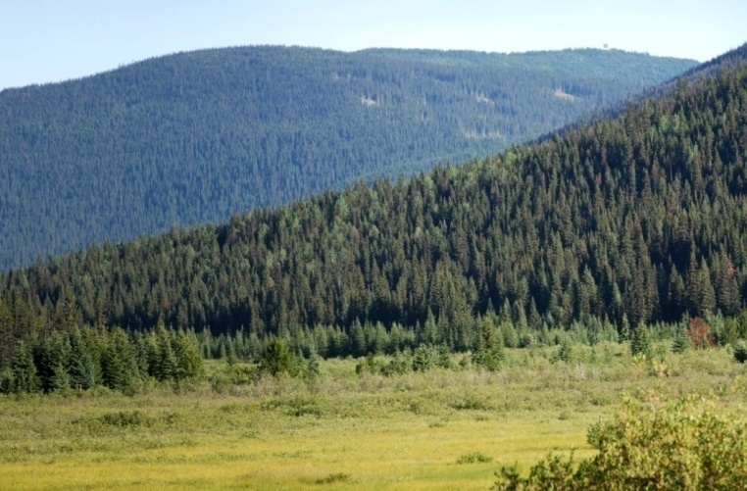
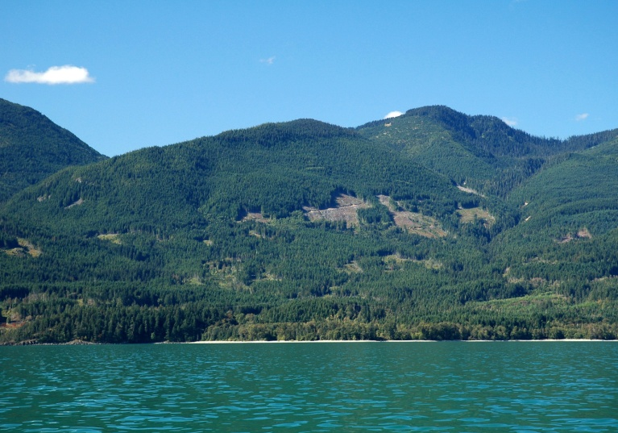
Visual Monitoring Results
Retention
Retention VQOs on highly sensitive landscapes are achieved 56% of the time. Partial Retention is achieved 64% of the time.
Partial Retention
8

Slide 9
Visual Evaluation Procedures
The visual evaluation approach assesses each view using two independent measures:
the basic definition for each category of alteration (VQO) is evaluated through an ocular assessment and;
the perspective percent alteration and design elements are assessed using standards and criteria derived through research.
The two measures are combined to determine a final rating.
9

Slide 10
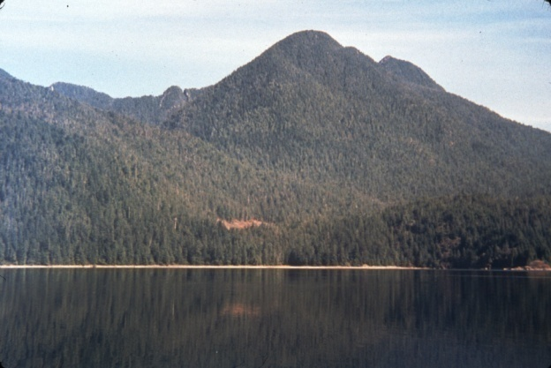
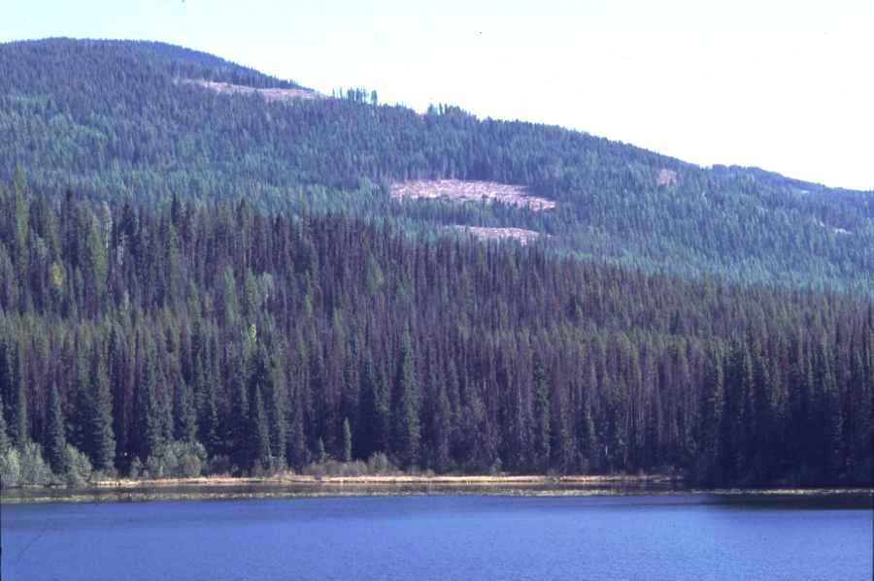
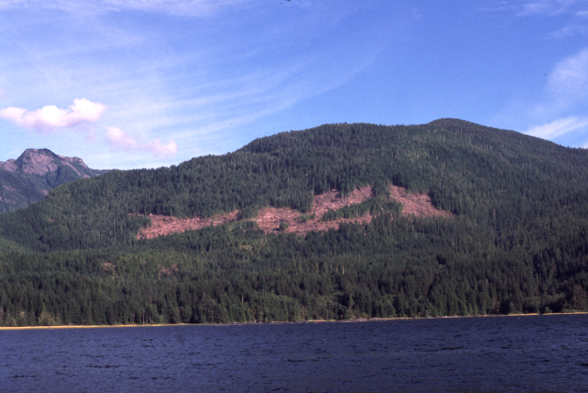
Visual Quality Objectives
VQOs are management objectives established by the DM under the Government Action Regulation Sect 7(2), grandparented from the Code, or set in Higher Level Plans. They are used to reflect society’s desired level of visual quality on the landscape.
The Forest Planning and Practices Regulation S.1.1 defines 5 categories of alteration: Preservation, Retention, Partial Retention, Modification & Maximum Modification.
Retention
Partial Retention
Modification
10

Slide 11
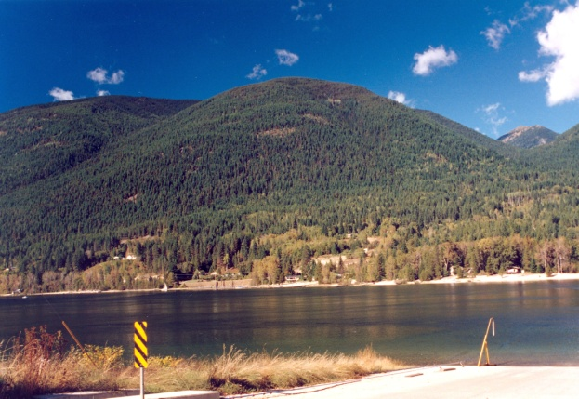
Visual Quality Objectives
Preservation:
Alteration, when assessed from a significant public viewpoint, is:
very small in scale, and
not easily distinguishable from the pre-harvest landscape
11

Slide 12

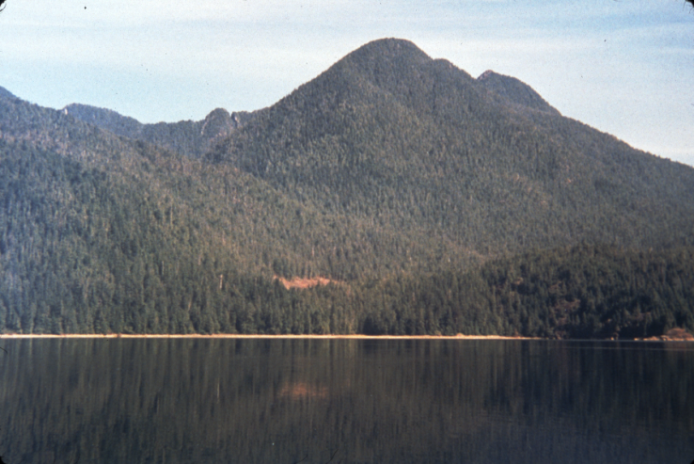
Visual Quality Objectives
Retention:
Alteration, when assessed from a significant public viewpoint, is:
(i) difficult to see,
(ii) small in scale, and
(iii) natural in appearance.
0.3%
> 1%
Predicted by 0 - 1.5% alteration
0.9%
12

Slide 13
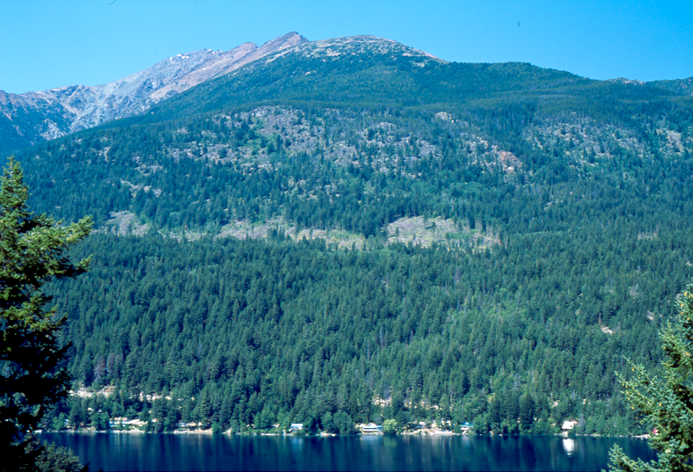

Visual Quality Objectives
Partial Retention:
Alteration, when assessed from a significant public viewpoint, is
(i) easy to see,
(ii) small to medium in scale, and
(iii) natural and not rectilinear or
geometric in shape.
3.1%
Predicted by 1.6 - 7.0% alteration
7.0%
13

Slide 14
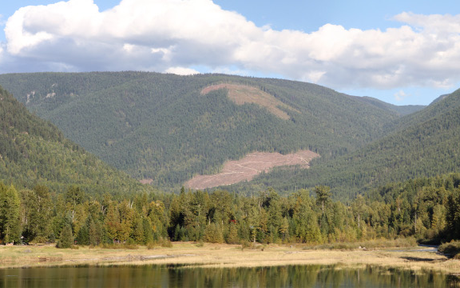
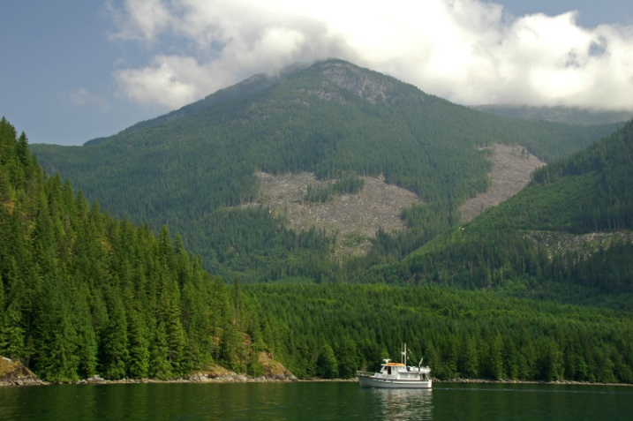
Visual Quality Objectives
Modification:
Alteration, when assessed from a significant public viewpoint, is
is very easy to see, and
is (A) large in scale and natural in its appearance, or (B) small to medium in scale but with some angular characteristics;
8.6%
Predicted by 7.1 – 18.0% alteration
7.3%
17.0%
14

Slide 15
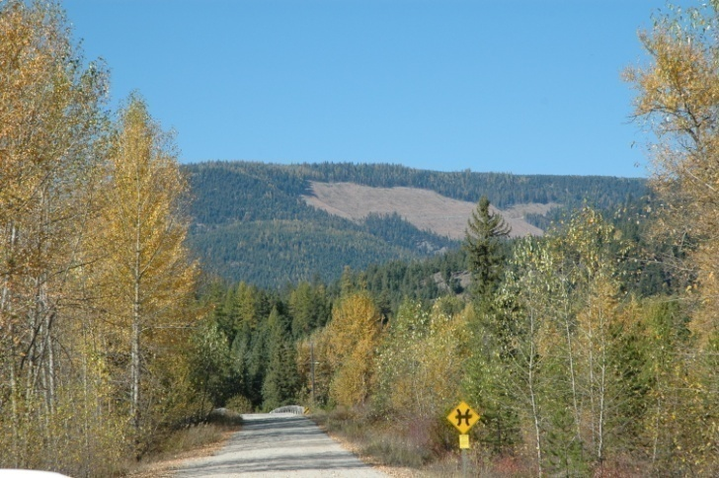
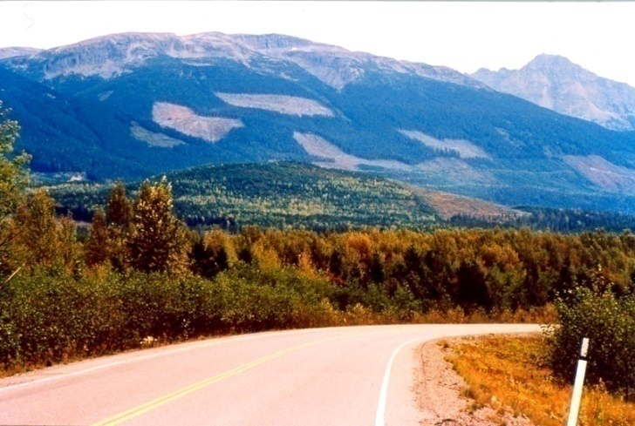
Visual Quality Objectives
Maximum Modification:
Alteration, when assessed from a significant public viewpoint, is
very easy to see, and (ii) is
(A) very large in scale,
(B) rectilinear and geometric in shape, or
(C) both.
19.0%
Predicted by 18.1 – 30.0+ % alteration
17.9%
15

Slide 16


Significant Public Viewpoint
FPPR proposed definition
A significant public viewpoint:
a place or location on the land or water that is accessible to the public,
provides a viewing opportunity and has relevance to the landform
being assessed.
16

Slide 17
Choosing Viewpoints for Evaluations
Examples of viewpoints that might be considered when
doing an evaluation (or VQO Inspection):
a stretch of highway leading toward a harvest unit (i.e. focal view)
a rest stop,
a recreation site or park,
a group of homes, or settlement, or
a tourist-related commercial enterprise.
It is important to review the location(s) offering the best or most direct view of the alteration. This may not necessarily be a viewpoint that provides a stationary or stopping location.
Same alteration can be assessed from multiple viewpoints.
Warning: Visual Landscape Inventory viewpoints are used to derive visual sensitivity unit boundaries and to rate the visual sensitivity of the landscape.
They are not derived specifically to assess VQO compliance.
17

Slide 18
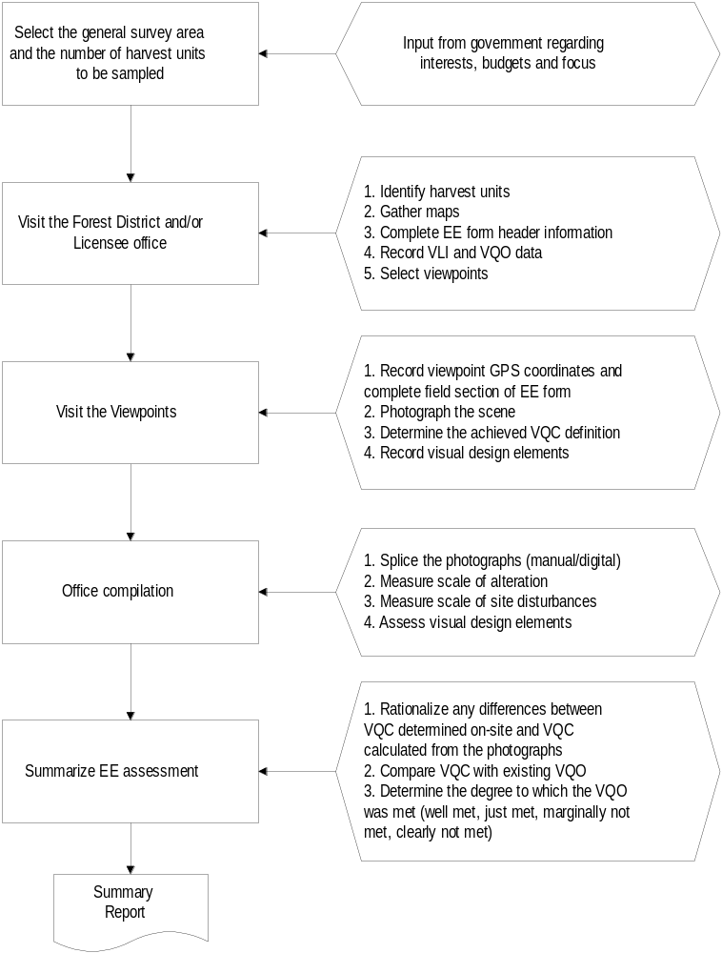
1
2
Flow chart showing
steps involved in conducting a Visual Quality Effectiveness Evaluation
Page 5 of your Manual
3
4
5
18

Slide 19
Step
1
Select the survey area and number of harvest units to be sampled.
Choice of survey area will depend on who is doing the evaluation and what the goals and objectives are.
The goal up until recently, was to develop a provincial data set to compare Code management to FRPA.
A district or licensee may wish to establish a bench mark in terms of performance under the Code, may wish to compare ongoing performance or may simply want to know if a VQO’s are being achieved.
19

Slide 20
Step
2
Visit the District and/or Licensee Office.
Identify harvest units to be sampled.
Gather up maps for navigation purposes and to locate cut block on the landscape.
Complete EE header form.
Record VLI data and VQO for area.
Pre-select possible viewpoints using VLI and completed VIA packages if available, and confirm selection in the field.
Remember, you are not bound by these viewpoints.
Determine each viewpoint importance used for evaluation. (This may be used to weigh the EE ratings from multiple viewpoints in case individual EE ratings differ.)
20

Slide 21
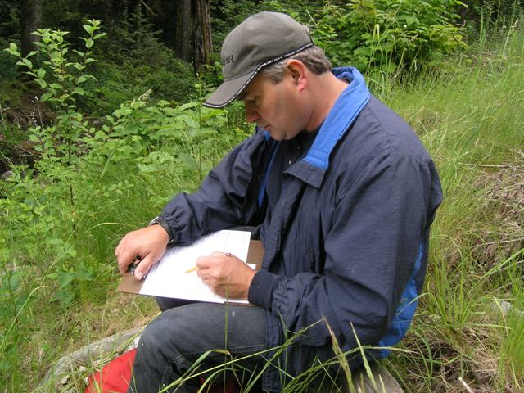
Step
3
In the Field
Check the validity of the pre-selected viewpoints and add/delete from the selection as needed.
At each viewpoint record the GPS coordinates and complete field section of EE form.
Photograph the scene. Capture entire landform with overlapping photographs if needed.
Mentally delineate the landform against which the alteration will be evaluated.
Using the above landform determine which category of alteration definition has been achieved.
Record the visual design elements present
or absent in cut block.
21

Slide 22
Step
4
4
Office Compilation
Stitch the photographs together.
Define the landform.
Measure the scale of alteration(s)
(digital planimeter or computer).
Measure the scale of site disturbances
Confirm visual design elements seen in the field by doing lines of force analysis.
22

Slide 23
Step
5
Summarize EE assessment.
Rationalize any differences between VQC determined in the field (Legal Definition) and VQC scale (% alt.) calculated from the photographs.
Compare achieved visual condition with VQO.
Determine the degree to which the VQO was met or not met.
23

Slide 24
Necessary Evaluation Skills
Taking photographs
Stitching photos (manual/digital)
Know where to get VQO data
Understanding the Landscape
Measuring percent alteration
Understanding research results
Assessing Visual Design
Safety
24

Slide 25

Taking Photographs
Weather should be clear (90% cloud free).
Avoid cloud shadows on landform under assessment.
Illumination is strongest in the summer months.
East-facing units are best photographed in the morning,
west-facing units are best photographed in the afternoon.
Plan your day accordingly.
Side-lighting is beneficial for accentuating terrain detail.
Use a high-resolution digital camera.
(Point & Shoot cameras not recommended-no control on focal length)
Take two sets of photos from each viewpoint:
- one set at 50-70 mm (human eye equivalency)
- the second set zoomed in to capture opening detail.
Often a series of overlapping photographs (25% overlap minimum)
are required to capture the entire scene.
Do not modify camera settings between shots.
Panoramas are best taken with a tripod.
25

Slide 26
Splicing Panoramas
In those cases where you have taken multiple overlapping images they have to be stitched together.
Many digital cameras come with a panorama stitching software (e.g. Canon Photo Stitch). In this case you would import the images into the software and stitch the photos together.
There are other digital stitching products available on the open market, e.g.:
http://www.arcsoft.com (Arcsoft Panorama Maker)
http://www.panavue.com (ImageAssembler 3 – Free )
http://cs.ubc.ca/~mbrown/autostitch/autostitch.html (Free)
http://www.panoguide.com (How-to Guide to Creating Panoramas)
26

Slide 27
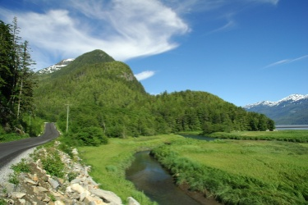
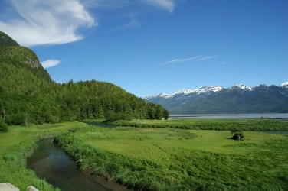
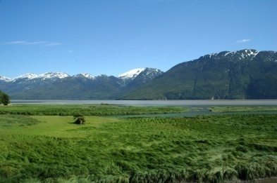
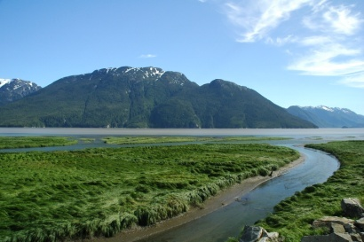
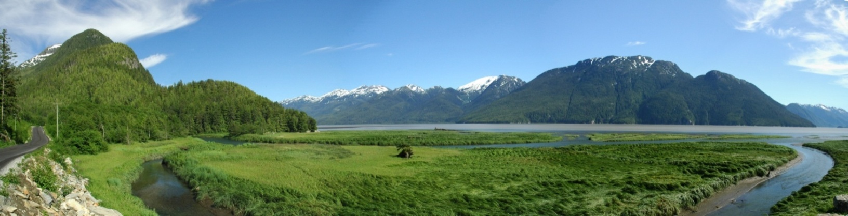
Splicing Panoramas
Good for documenting large landscapes, setting or context.
Horizontal & vertical panoramas.
Specialized software, in camera or PC-based. (e.g. Panorama Maker)
Use std lens to slight telephoto (i.e. 50-70 mm); avoid wide angle lens.
25-30% overlap, sequential L-R, level, tripod
Don’t adjust zoom/settings between shots, avoid polarizing filter, constant exposure lock
27

Slide 28
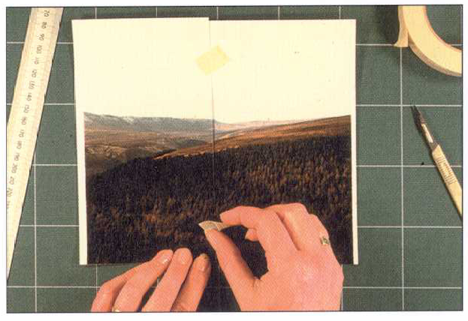
Splicing Panoramas
In circumstances where you don’t have computer-based tool, you have two choices:
You can import your photos into PowerPoint and then crop, size and merge them.
You can print photos, trim the overlap and splice them together by hand.
28

Slide 29
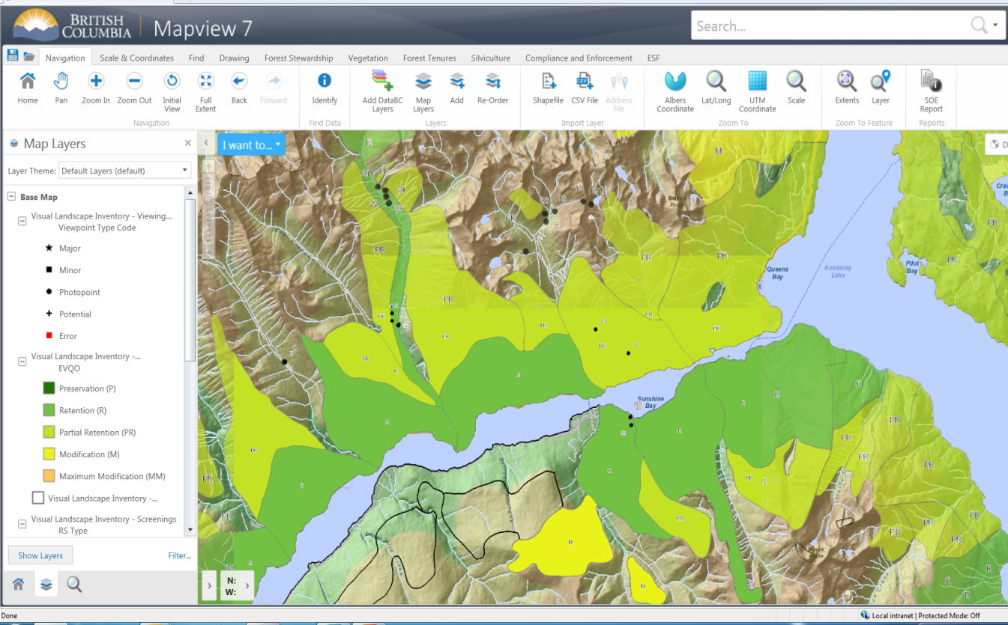
Know Where to Find VQO Data
As of now, most established VQO’s are available in the BC Geographic Warehouse (aka BCGW).
This information can be accessed using either the Map View application
or the Visual Inventory Online application.
http://maps.gov.bc.ca/ess/sv/visinv/
https://arcmaps.gov.bc.ca/ess/sv/mapview/
If you are in doubt as to which information to use consult with your Regional Visual Specialist.
29

Slide 30
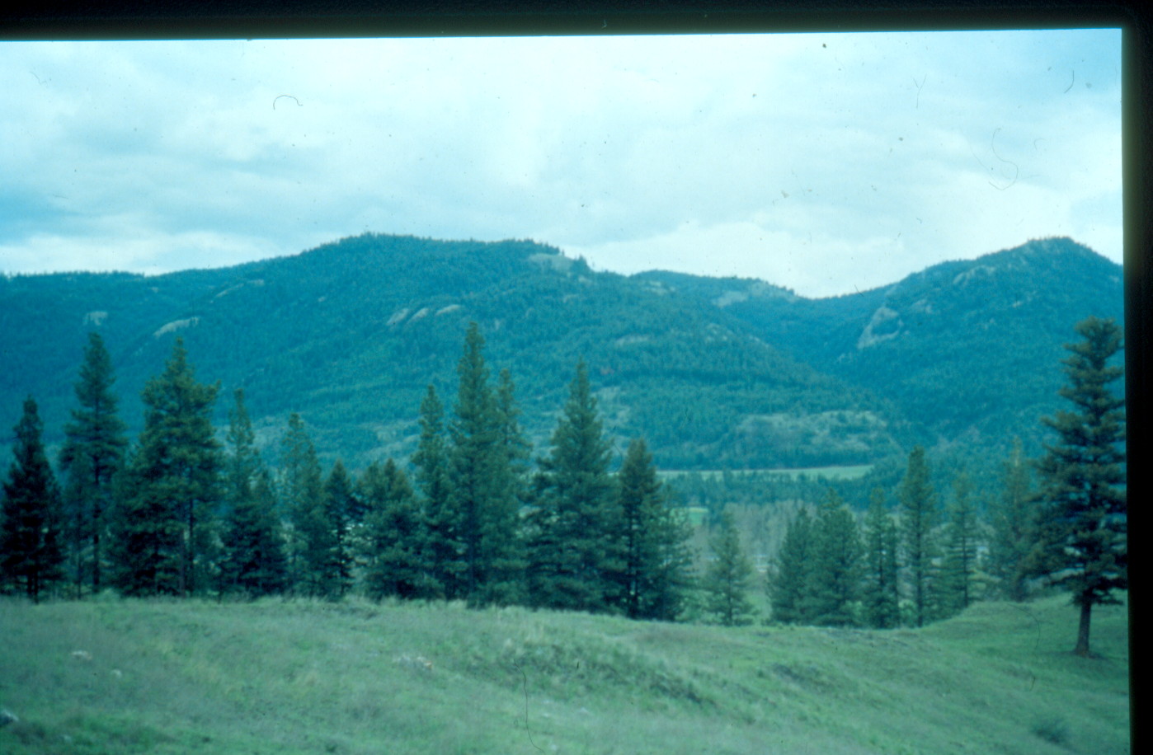
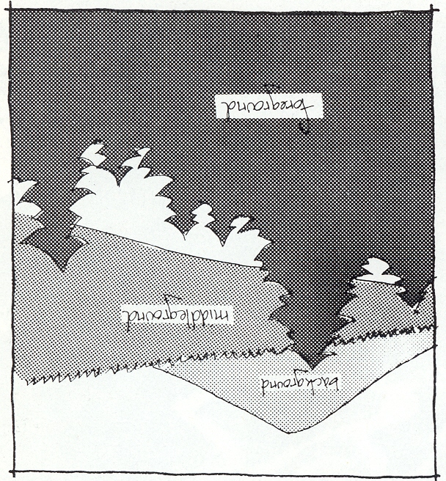
Understanding the Landscape
The existing Visual Resource Management Program was developed to address alterations on the mid-ground & background landscapes.
More than 8 Km
Background
Midground
1- 8 Km from viewer
Foreground
0-1 Km from viewer
We are only now conducting the research necessary to manage the foreground views.
30

Slide 31
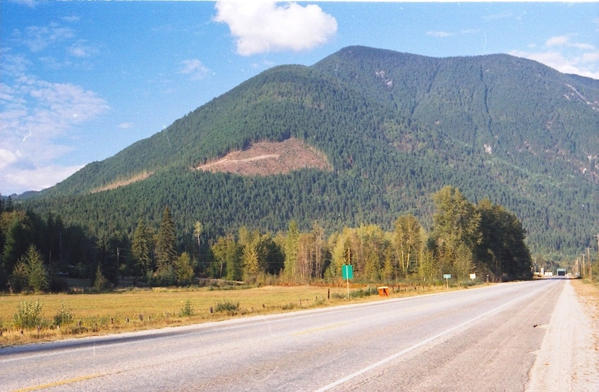
We manage alterations on landforms as opposed to the total scene.
Background Not Included
Landform outlined in yellow
Foreground Not included
Landform: a distinct topographic feature that is three dimensional in form and is generally
defined by ridges, valleys, shorelines and skylines. Examples include hills and mountains.
80% of the time landforms are reasonably easy to define.
31

Slide 32

5. Measuring % alteration
B
A
C
Area
B + C
% Alteration
Total Green Landforms
X
100
=
Area
A
32

Slide 33
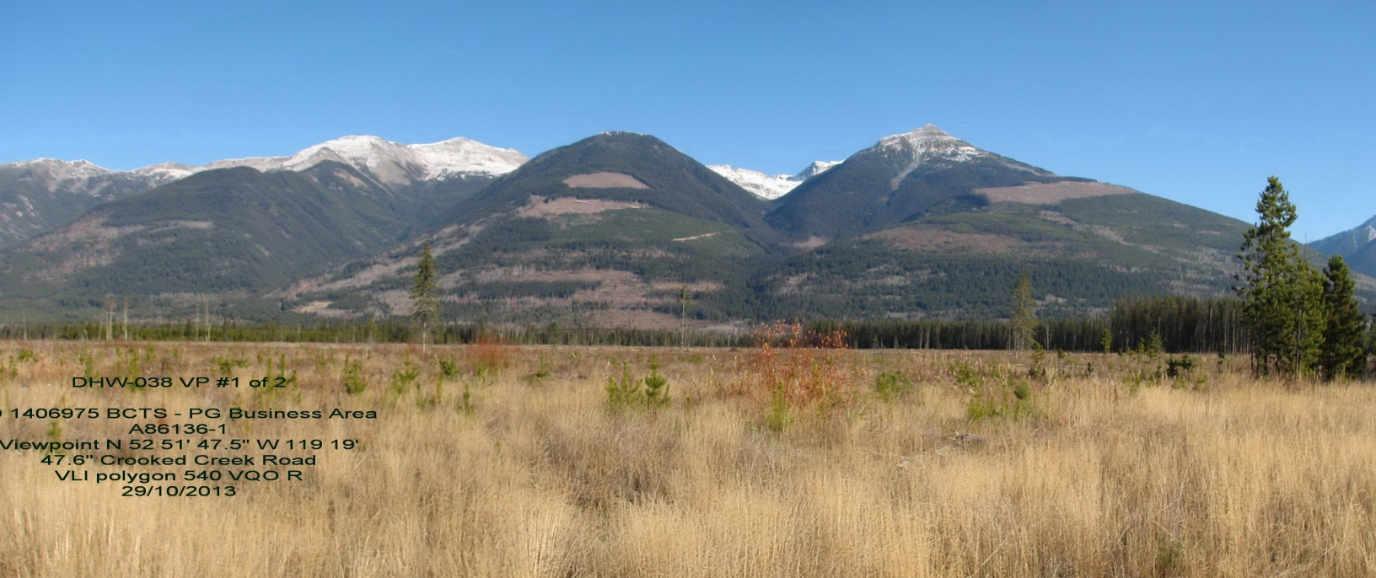
More on Defining Landform
One rule used to help define a landform is to determine if a creek draw bisects the topography. Where this occurs, independent landforms (topographic features) are created. Where a creeks does not bisect the topography, independent land forms are not created.
Creeks do not bisect topography
Creeks bisect topography creating separate landforms
33

Slide 34
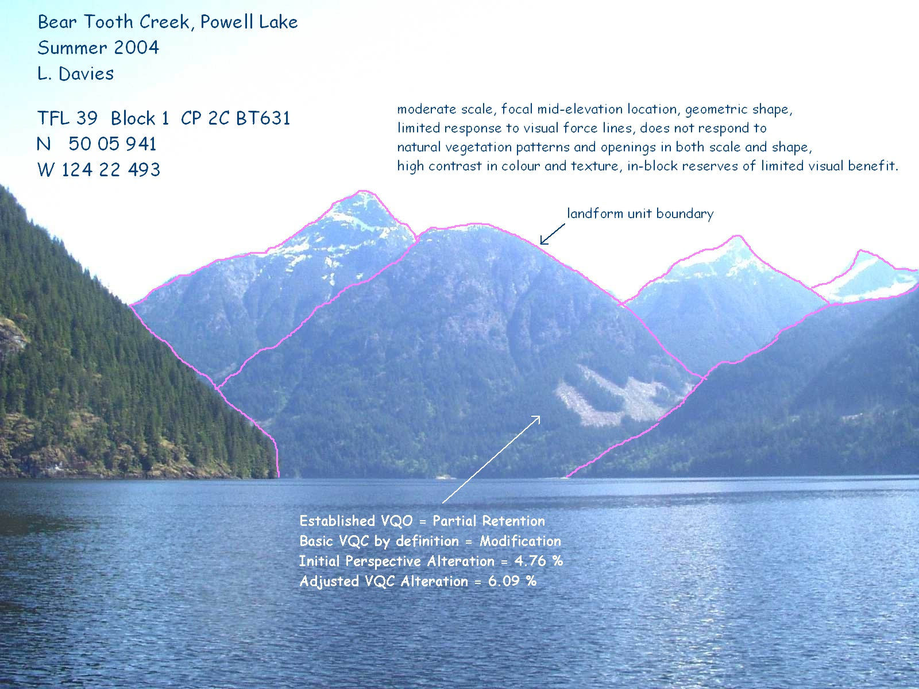
Area
For Landforms with Rock Snow & Ice
C
% Alteration
X
100
=
Area
B
A
Non Green
B
C
Green
(Includes inoperable)
Alteration
34

Slide 35
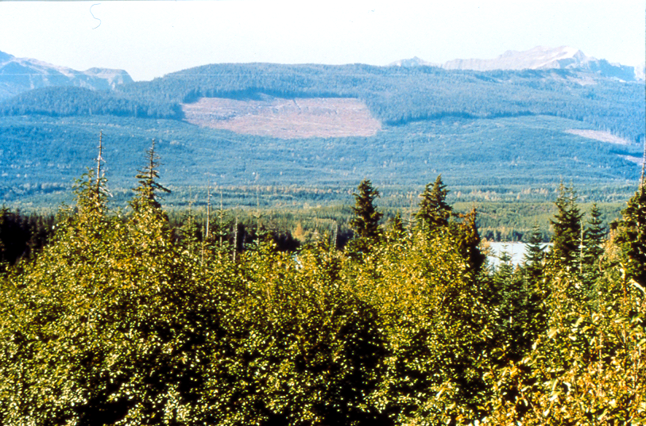
New block & old block that is partially greened up.
Old Growth
Visually Greened Up
25

Slide 36
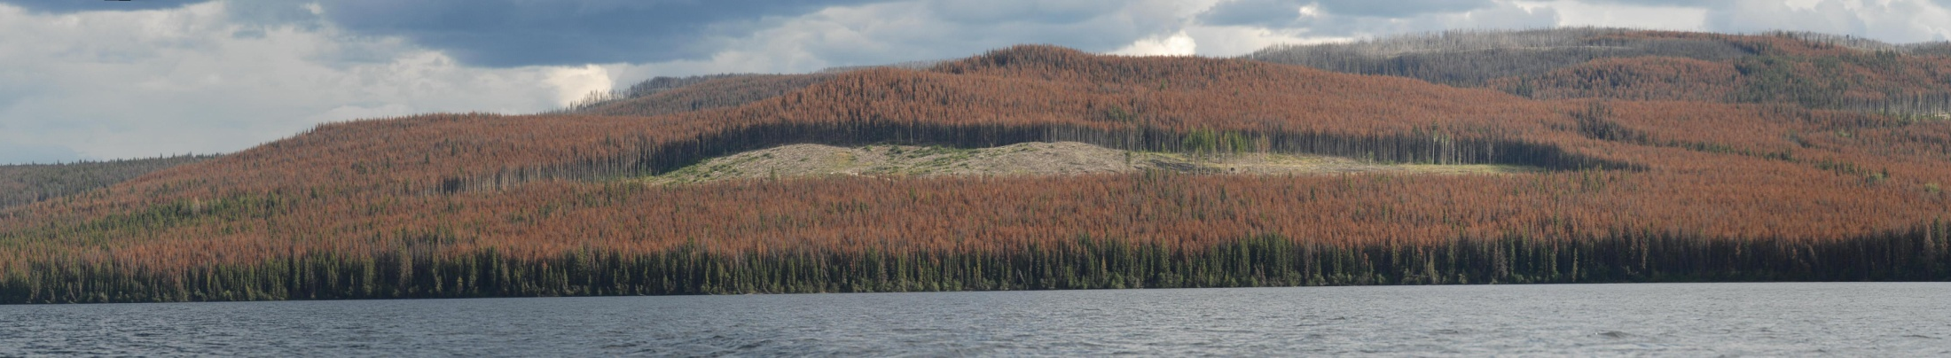
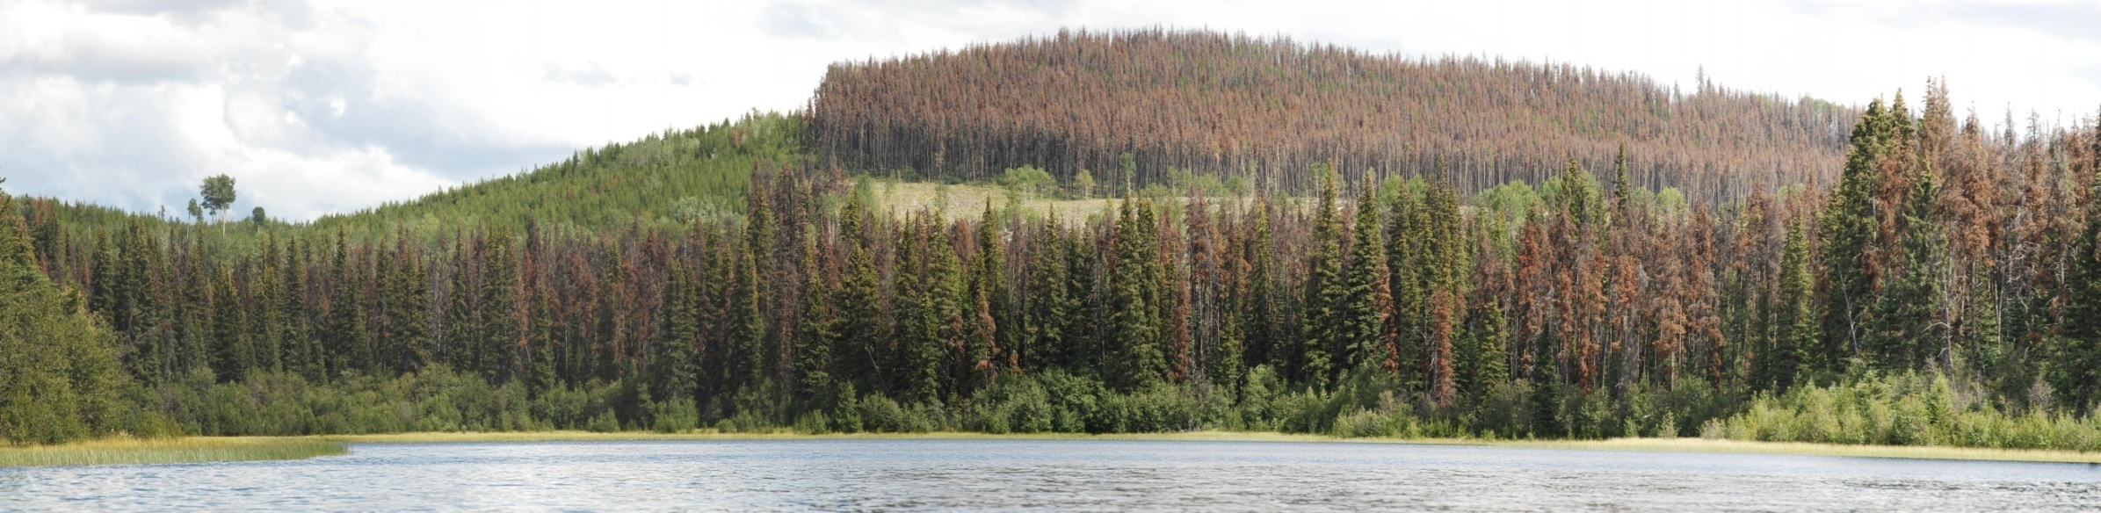
Shoreline Treatment
Greater than a Kilometre include Shoreline Trees
Less than a Kilometre exclude Shoreline Trees
36

Slide 37
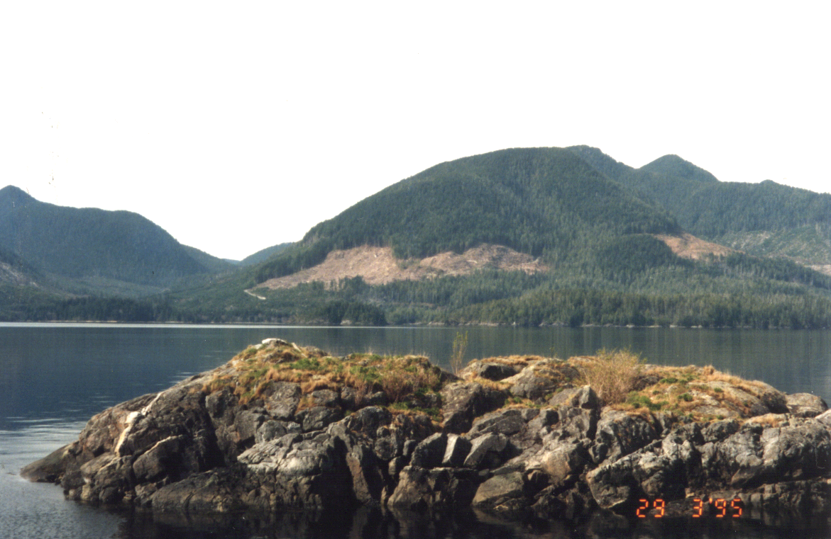
Exercise #1 Measuring Percent Alteration
26
37

Slide 38
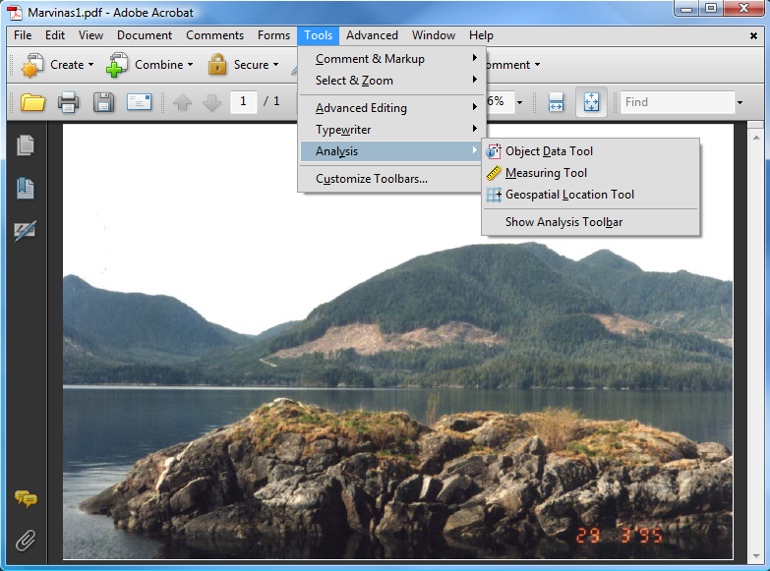
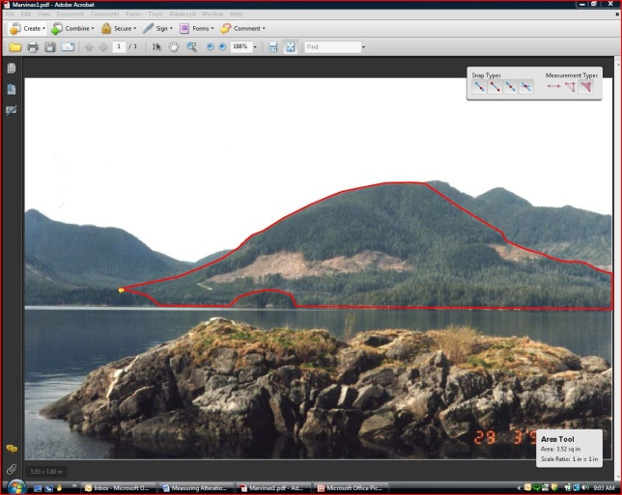

Using Adobe Acrobat Standard to Measure Percent Alteration
To speed up percent alteration calculations you can now import your photo into Adobe Acrobat Standard and perform area measurements digitally.
You will require a full version of Adobe Acrobat X Standard to perform this function (via iStore).
Once you have Acrobat Standard, you simply digitize the landform and openings and do the percent alteration calculation.
38

Slide 39
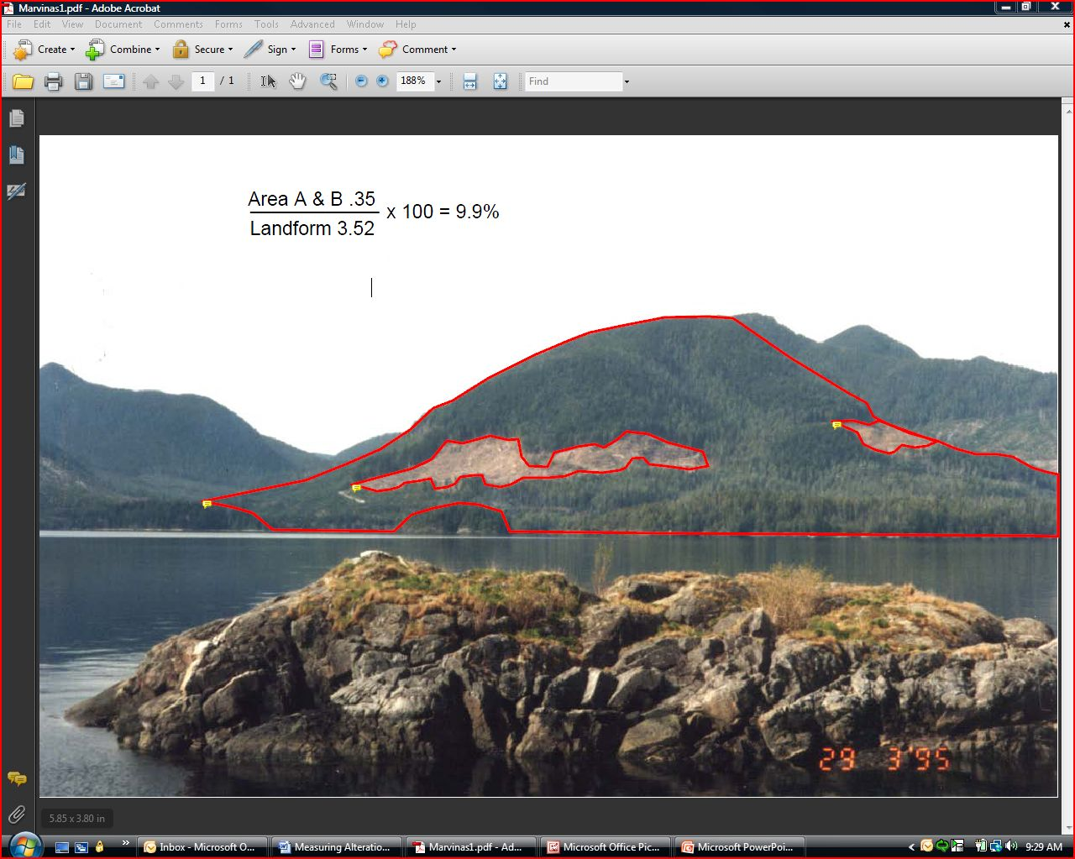

Slide 40
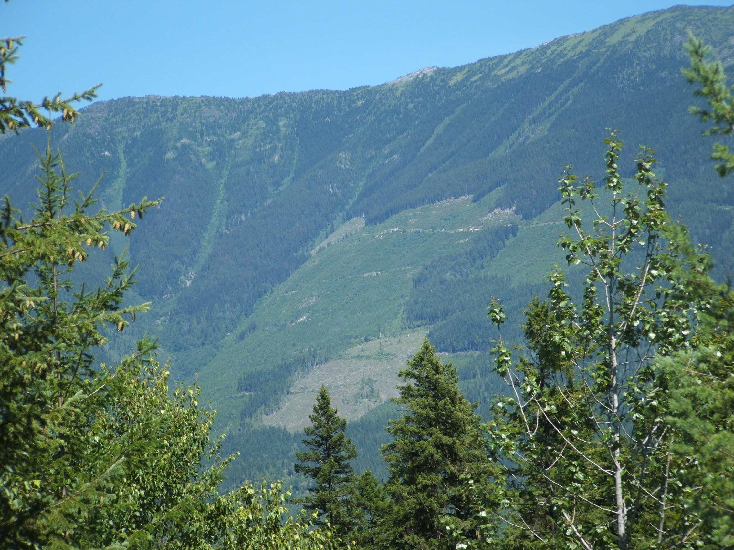
More on % Alteration
It is important for % alteration to accurately
predict the visual result.
What VQO has been achieved if you use the Ocular Assessment?
40

Slide 41

If we only consider the new blocks in this landscape, the measured 4.2 % alteration would predict Partial Retention.
Why is this not in sync with the Ocular Assessment?
41

Slide 42

Reason: there is a residual impact from the old harvesting which hasn’t been accounted for.
VEG is achieved when forest cover generally blocks views of tree stumps, logging debris, and bare ground.
What degree of visual recovery has been achieved? 50, 60, 70%
42

Slide 43
15%
If we assume the old block has recovered by 70% this means it still contributes 30%: .30 x 15% = 4.5% residual impact.
4.5% Residual plus 4.2% new = 8.7%. This predicts Modification which is more in line with the ocular assessment.
43

Slide 44

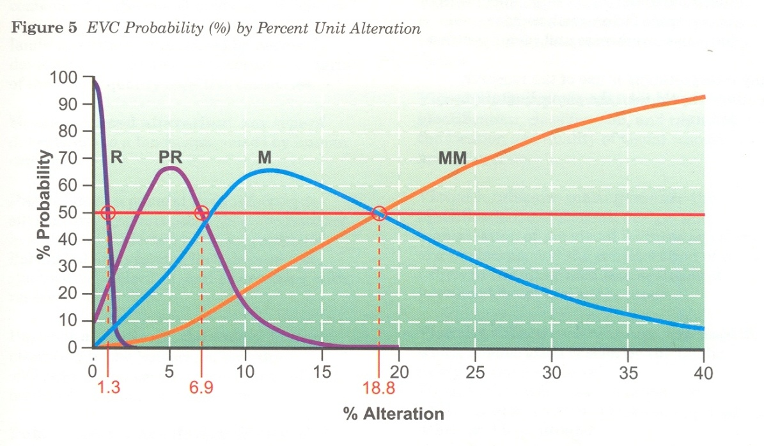
6. Research Results
One goal of the Clear Cutting to Meet Visual Quality study was to determine what parameter in the landscape could be used to predict the Visual Quality of Clear Cuts.
The study found that % landform harvested was the best single predictor.
Retention and Partial Retention classes could be predicted at a probability of 77.8% and 85% respectively.
This graph shows the probability (50%+1) that a clear cut would be classified into a particular VQO based on % alt alone.
Clear Cutting to meet Visual Quality 1996
44

Slide 45
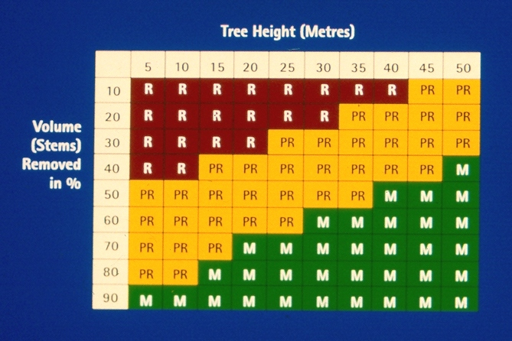
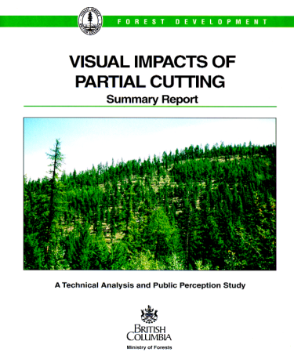
6. Research Results
The goal of the Partial Cutting Study was to determine which site and stand variables would best predict Visual Quality.
The combination of variables; % volume removed, % stems removed and average tree height were found to be the best predictors of EVC.
This table was developed to provide the field practitioner with the ability to predict the out come of a selection cut based on a specific level of volume/stems removed.
Visual Impacts of Partial Cutting 1997
45

Slide 46
7. Assessing Visual Design
Assessing the visual design of a cut block is an important aspect of the evaluation process. The full range of concepts and principles to be evaluated are set out in the VLD Training Manual. Two day design workshops are generally offered annually.
One of the key questions that must be answered is whether or not the major visual lines of force were identified and used to develop the block shape.
The lines of force concept is based on the premise that as we observe the landscape, our eyes are drawn up hollows and down ridges.
Learning how to map and use visual force analyses is an important design concept for students to learn and understand as it is used as the basis for assessing the presence or absence of design of proposed cut blocks.
46

Slide 47
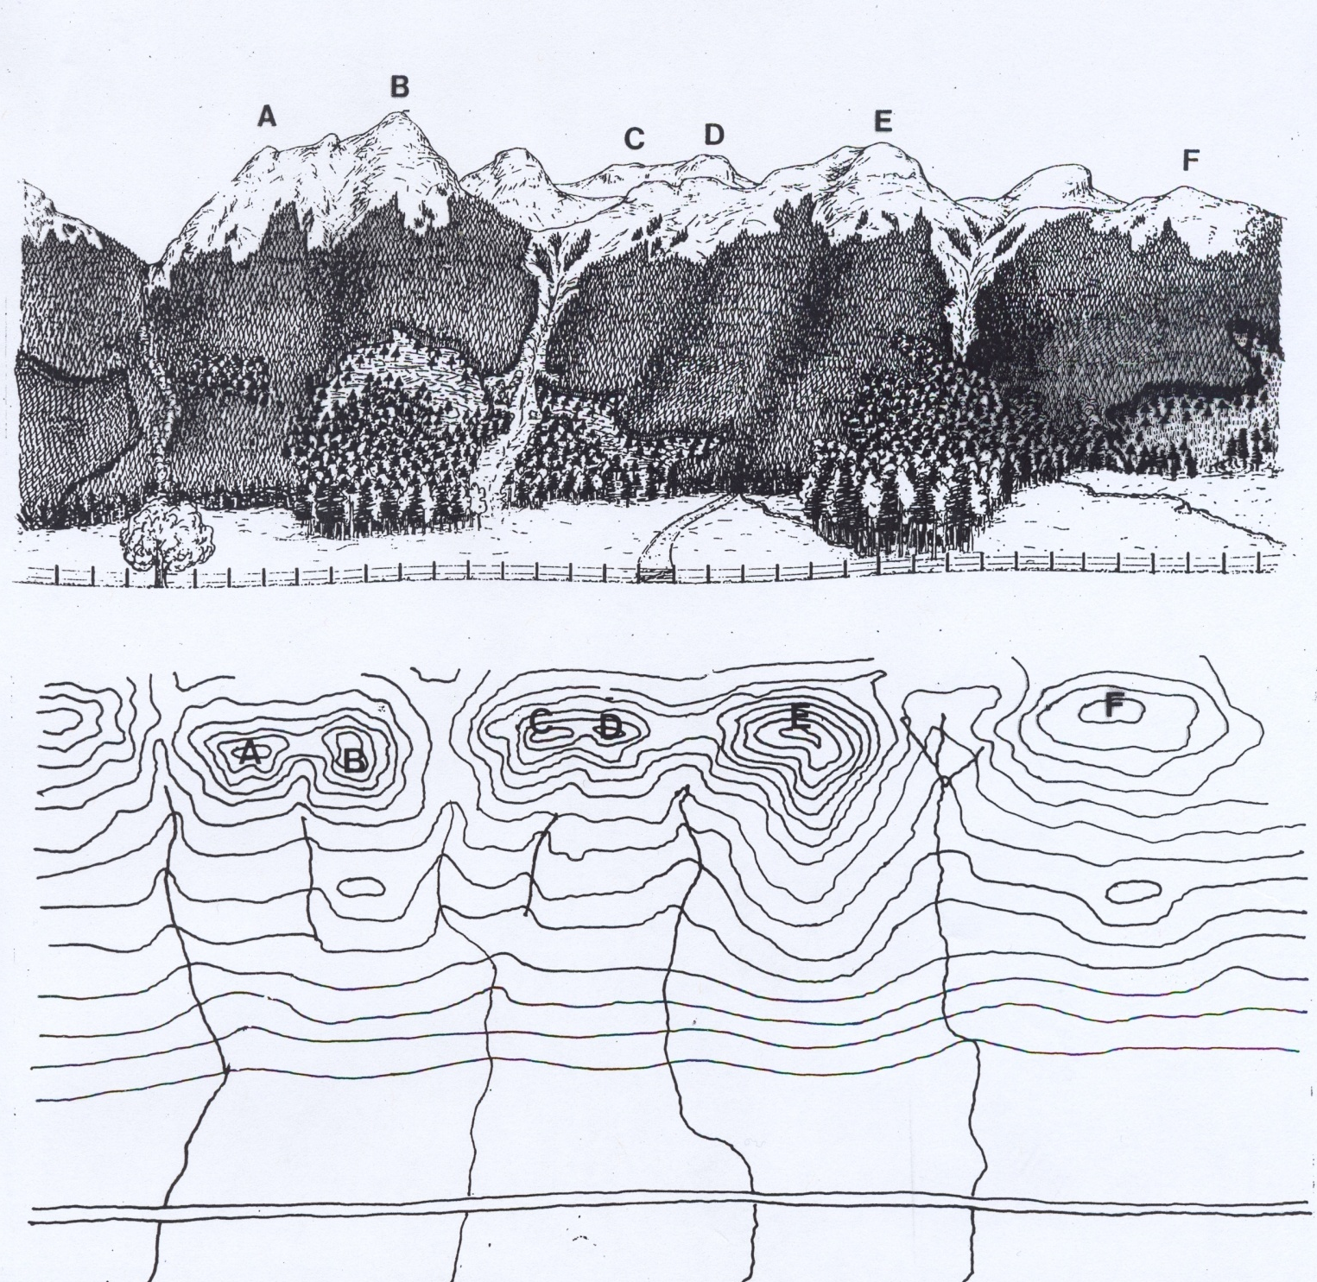
Demo
47

Slide 48
Lines of Force Demo & Exercise
STEP 1:
Identify and label all major peaks, summits, ridges and saddles on both the photograph and topographic map. These landmarks will help make the transition between plan and perspective easier.
STEP 2:
Starting on the photograph map out either the convexities (ridges) or the concavities (hollows). It is easier to start with ridges first then do hollows. Identify the strongest ridges or hollows first. The standard convention is to use RED down arrows to identify the RIDGES and GREEN arrows to identify GULLIES.
48

Slide 49
Ensure arrows follow the apexes of ridges and the bottom of creek draws as far as they can be seen and traced.
As a line is mapped on the photograph transfer it to the topographic map and vice versa.
Once the primary lines of force have been mapped, with a thicker line, secondary ridges and hollows should be mapped using thinner lines.
In most landscapes a dendritic branching pattern will emerge. This will often consist of 3 or 4 levels in hierarchy of forces, shown by different widths of arrows.
49

Slide 50
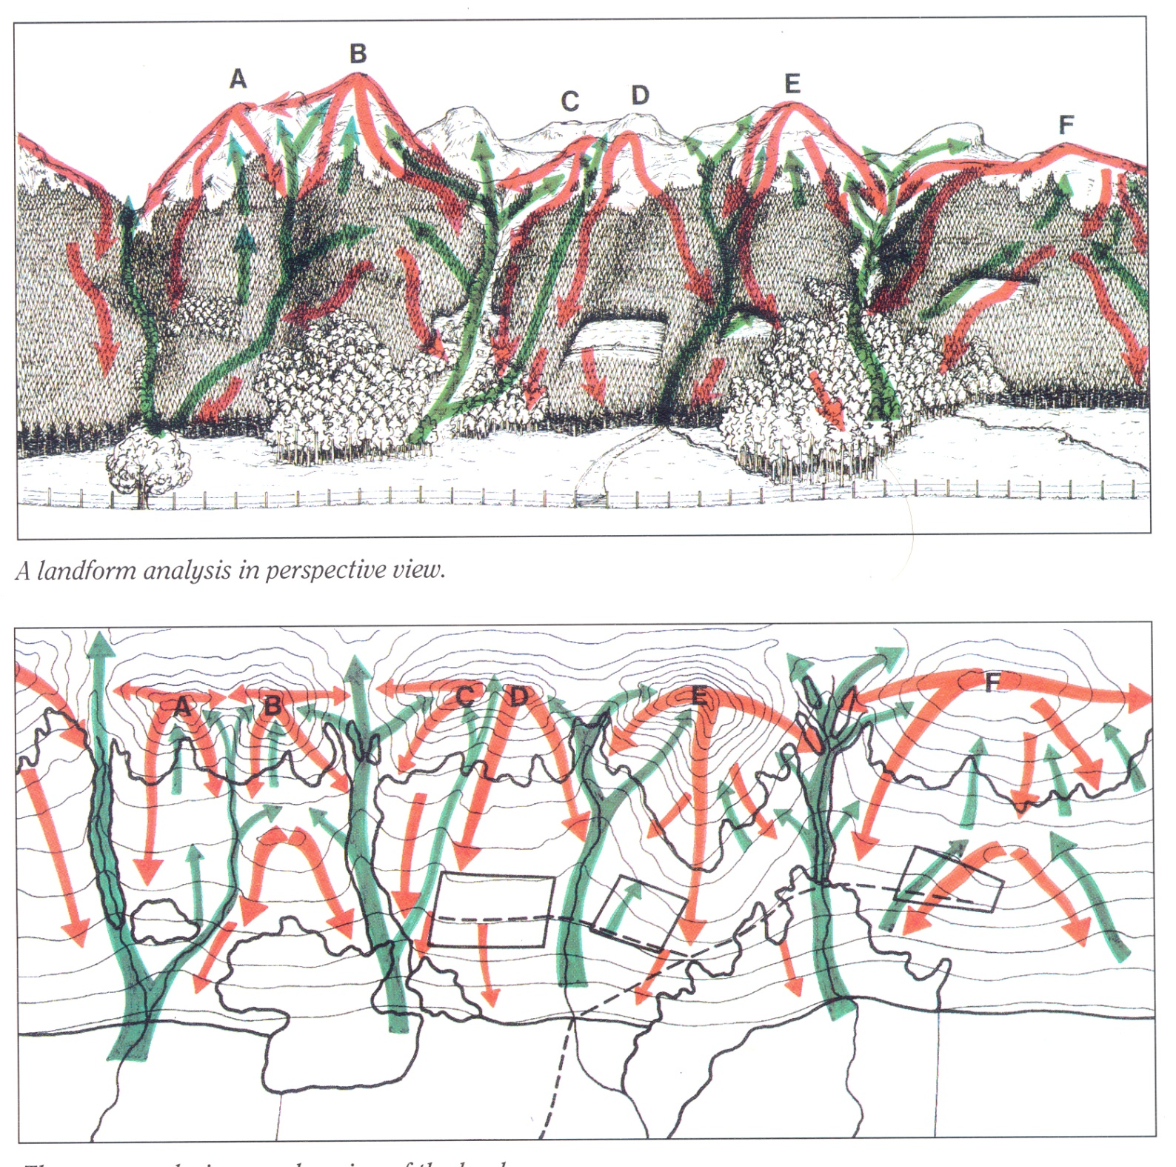
Completed Lines of Force Analysis in plan and perspective view
50

Slide 51
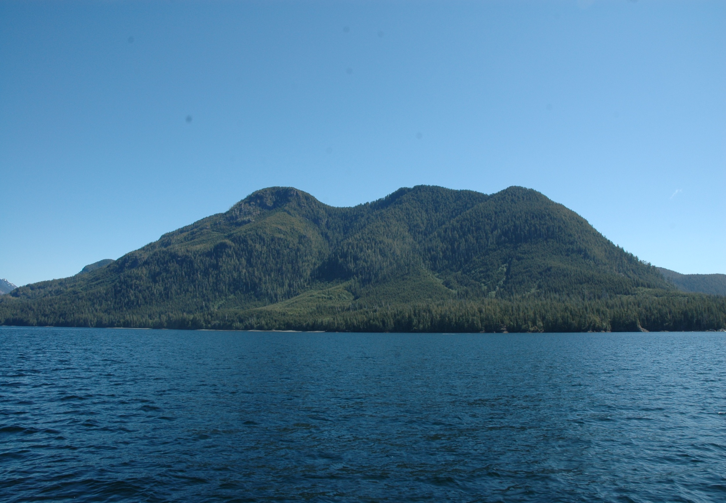
Exercise #2 Mapping Lines of Force
51

Slide 52
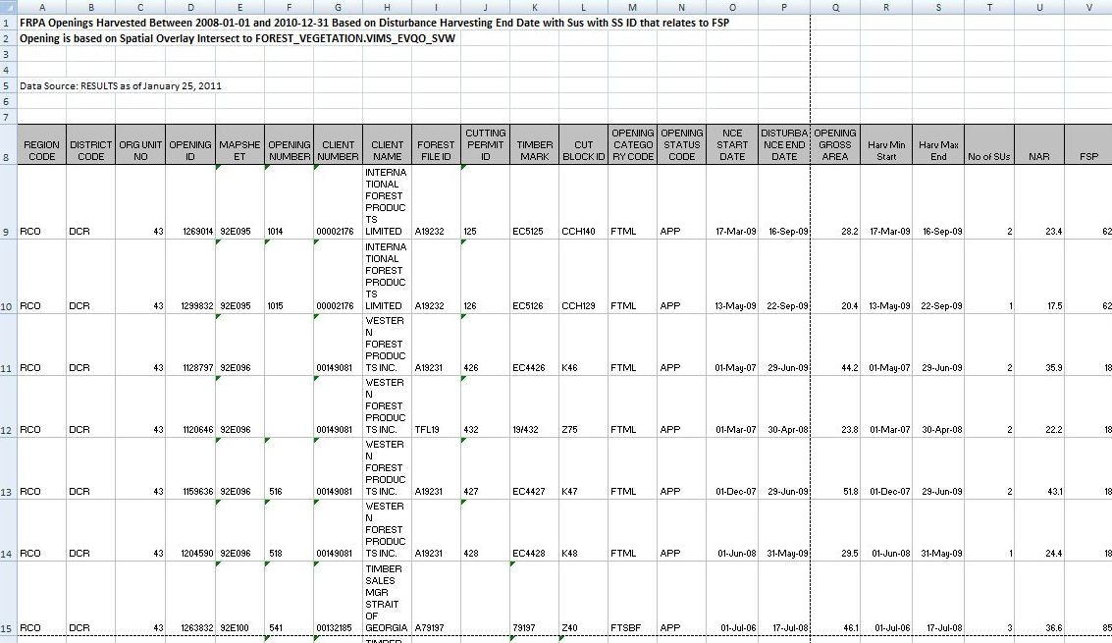
8. Choosing Evaluation Samples
In the spring of every year, FREP distributes a list of FRPA openings that have been harvested in the previous 3 years and are within VQO polygons. This is the list to use for FREP Visual Quality sampling.
Districts will find a tab for their respective districts to the left of the excel sheet.
52

Slide 53
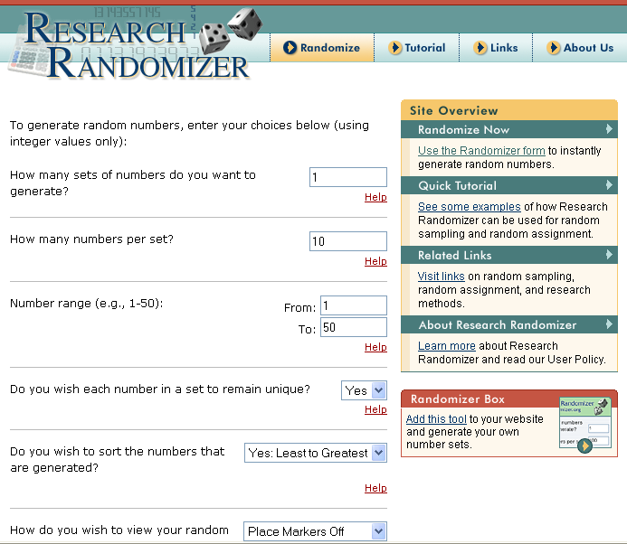
8. Choosing Evaluation Samples
Regardless of how many openings a district has on its list,
all samples have to be chosen randomly. We do not want
targeted block (unless it is
for the purpose of doing
a C&E VQO Inspection).
The best way to do this is put the list through a randomizer.
http://www.randomizer.org/form.htm
53

Slide 54
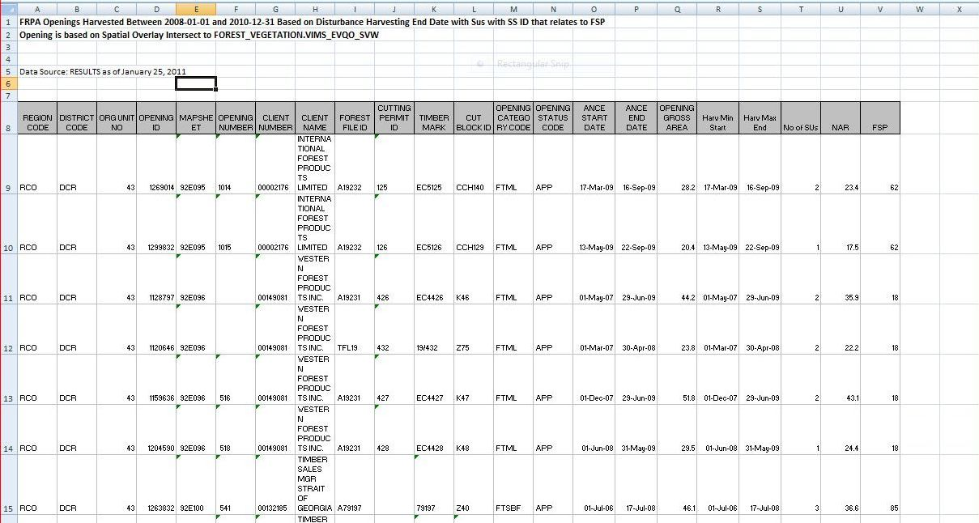
8. Choosing Continued.
1
2
3
4
5
6
To choose the openings to be sampled, first add an extra column to your excel spread sheet and label the samples chronologically starting at 1.
If you have 50 FRPA openings listed, but only wish to sample 10, feed this into the randomizer. Once initiated the randomizer will give you 10 random numbers between 1 and 50 and these will be the samples you collect.
54

Slide 55




9. Safety
Effectiveness Evaluations are often done from busy highways and high traffic areas.
Evaluators should:
use vehicle emergency flashers or a
portable amber flashing roof light.
wear bright safety vests and
use traffic cones when stopped
and working along highways.
55

Slide 56

Completing the Effectiveness Evaluation Form
We will now work through the various components of the EE form.
The coloured sections will be more fully explained as we progress through this slide show.
There are two streams one for clear cuts and one for partial cuts. Section 2.3.4 deals with partial cuts and will be dealt with later.
56

Slide 57

Completing the Header
Columbia
DCO-006
Bell Pole
July 27, 2007
A18992
CP 18 BLK C01006
Dupont Creek
Step 1: Fill in the administration info (District, licensee, Blk coding, etc.) in the office.
The Sample Code is a tracking identifier that facilitates coordination between field sheets, photography, and subsequent databases. For this project the District initials followed by a sample number starting at 001 should suffice. Districts continue with the numbering sequence from where they finished off the previous year.
Note: One form is to be completed from each viewpoint selected for
evaluation. In some cases a block may be evaluated from multiple
viewpoints. The rating derived from the most significant viewpoint
will be used to reflect the final rating.
57

Slide 58
Record VLI and VQO Information
June 2003
M
M
2449
3
2000
MM
N/A
DM Letter
Step 2: Fill in VLI and VQO information.
Confirm the established VQO and date of establishment by checking source documents, i.e. the VLI database, District Manager letter, or HLP.
58

Slide 59
Record Viewpoint & Take Photos
1
117º 59’ 26.7
56º
50º 41’ 58.7
518 M
5 KM
26º
NKN_024-027
Unofficial Stop
10º
Step 3:
Choose Viewpoint and take Photographs:
It is important to choose viewpoints that provide a good view of the block being assessed. These may be viewpoints that were used by the licensee in their Visual Impact Assessment, viewpoints identified in the VLI or may be completely new locations within the general area where the original inventory was conducted and VQOs established.
Record particulars of the viewpoint and the view to the opening.
Record the photography information.
59

Slide 60
Assess Basic Definition
Step 4:
Using the written definitions of visual quality classes in Table 1 of the EE procedures & standards document or on the back of the form, compare their descriptions to the alteration present on the landscape.
Determine which category of alteration is the best fit and identify the class on the bar graph. You may wish to refine your initial determination by identifying whether the determination is toward the low, mid or upper range for the class.
60

Slide 61
Assessing Design
0
+1
+1
-1
+1
+2
Step 5:
Determine the influence of visual design, by answering the following questions with a Good, Moderate or Poor response.
1. Does the alteration respond to the major lines of force?
2. Does the alteration borrow from the natural character of
the landscape?
3. Have edge treatments been incorporated?
4. How far is the alteration from the viewpoint?
5. What position does the alteration occupy on the landform?
61

Slide 62
Assessing Initial VQC
11.7
0
11.7
M
Step 6:
The Initial VQC rating is assessed by measuring the scale of alteration on the landform and comparing the result with the percent alteration ranges in Table 2 below.
Visual Quality Class | Alteration % of landform in perspective view
P - Preservation | 0
R - Retention | 0 – 1.5
PR - Partial Retention | 1.6 – 7.0
M - Modification | 7.1 – 18.0
MM - Maximum Modification | 18.1 – 30.0+
62

Slide 63
Adjusting Initial VQC
X
+1
X
0
+2
+3
16.6
Step 7: Adjust Initial VQC
The initial % alteration figure (derived earlier from the photographs) is adjusted upward or downward, depending on the degree of positive or negative visual influences. Three aspects of the visual scene (site disturbance, tree retention & design) are assessed on a qualitative scale.
63

Slide 64
Determining the EE rating for the landform
Step 8:
Compare the Basic VQC determined using the definitions, with the adjusted VQC derived using percent alteration measurements and rate the opening by marking the appropriate box (Sect. 2.3.5 of the EE form or Sect. 5.5.1 of the C&E form).
The two evaluation methods will usually result in similar ratings, although they may lie on either side of a class boundary.
x
64

Slide 65
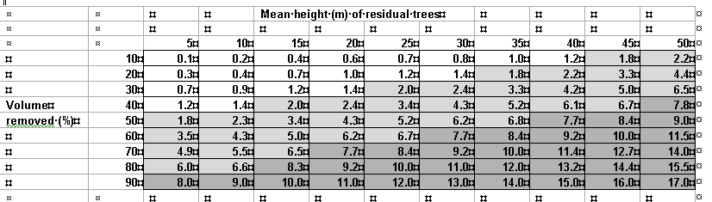
Procedures for Partial Cuts
Partial cuts are assessed for their Basic VQC in section 2.2.3 using the written definitions.
The Adjusted VQC is determined using a two-step “visual equivalent to clear cut” procedure. First you determine the percent volume removed by consulting Cutting Permit leave tree specs or by conducting an ocular assessment using the photo samples in Appendix 3 of the manual. With this number and the mean height of residual trees, go to the Table 4 and determine the “visual equivalent to clear-cut” alteration number. Plug this number into section 2.3.4 of the EE form (Sect. 5.4.4 of C&E form).
Note: Table derived from 1997 Partial Cutting Study.
65

Slide 66
Applying
What we have learned
66

Slide 67
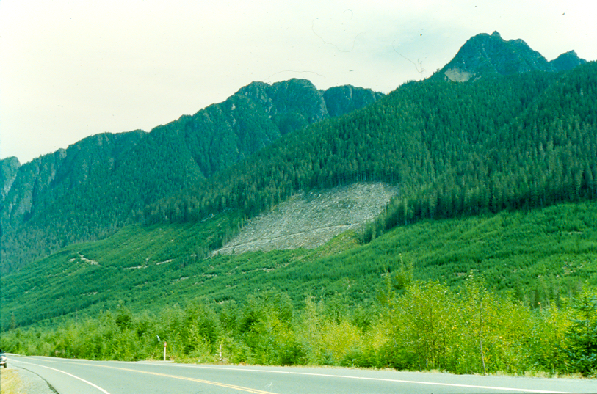
Step 1: Assess Basic Definition (Field)
Alterations meet which Basic VQC definition?
Circle where in the range for that VQC:
Basic VQC:
P R PR M MM
|----|----|------------|------------|------------|-------------|-------------|-------------I
easy to see, and is (A) large in scale and natural in its appearance, or (B) small to medium in scale but with some angular characteristics;
M =
MM =
very easy to see, and (ii) is (A) very large in scale,
(B) rectilinear and geometric in shape, or (C) both
67

Slide 68
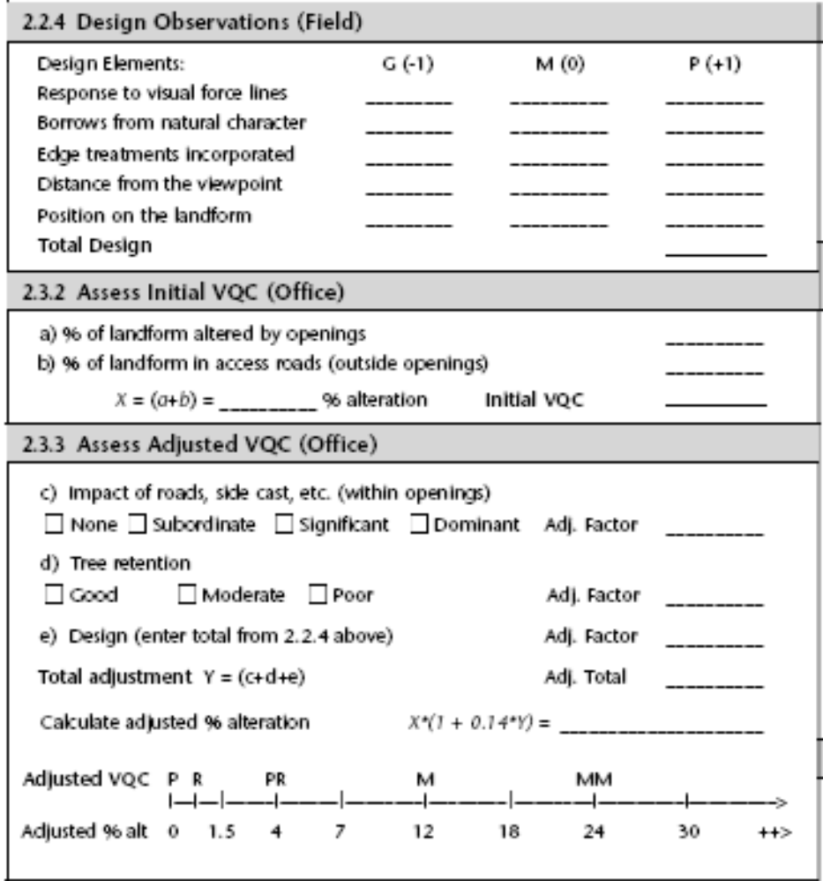
Step 2: Numerical &
Design Assessments
7.3%
7.3%
X
X
X
X
X
+ 5
7.3
0
7.3
M
The penalties for poor design almost doubles the % alteration for this opening moving it towards MM.
X
+1
X
0
+ 5
+ 6
13.4
68

Slide 69

Determine Final EE Rating by comparing the VQO derived by ocular assessment with that derived through the numerical/ design assessment.
Established VQO = M
x
69

Slide 70

Exercise #3 Lake Errock Evaluation
6
70

Slide 71


Exercise #3
Step 1: Carry out ocular
assessment.
Plot your position on line
using VQO definitions
Basic VQC:
P R PR M MM
|----|----|------------|------------|------------|-------------|-------------|-------------I
71

Slide 72
Exercise #3
Step 2: Analyse opening from a numerical &
design perspective and fill in the form
accordingly.
2.2.4 Design Observations
Response to Lines of Force “Poor”.
Distance from the viewpoint 2.3 Km.
2.3.2 Assess Initial VQC
Initial % alteration 8.7%
72

Slide 73
Exercise #3
X
X
X
X
X
+3
8.7
0
0
8.7
M
X
+1
X
-2
+3
+2
11.1
11.1%
8.7x [1+ (0.14 x 2)] =11.14%
73

Slide 74


Exercise #3
Established VQO PR
X
X
74

Slide 75
Equipment Needs
Hand compass
Altimeter
GPS Unit
SLR digital Camera with 50mm lens
and /or zoom lens (e.g. 18-200 mm)
Digital Planimeter
High Visibility Vest
Traffic Cones or portable amber flashing light.
Clip Board
75

Slide 76

Thank You

